Slide 1


Intro to Data Analysis
October 2022

Slide 2

Agenda
Intro & Meet the lecturers
Challenges to be a DS
Why Cloud is essential?
Why Data Analysis?
Why Pandas and NumPy?
Common IDEs and tools
Installation
Q&A

Slide 3

Motivation

Slide 4


Reslan Tinawi
BSc degree in information engineering from Damascus University.
Software Engineer from 2018 to 2020.
Data Scientist from 2020 to present.
Data Science Mentor at Syrian Youth Assembly
Personal blog: reslan-tinawi.github.io

Slide 5
Soubhi Hadri
Data Scientist at Microsoft, USA.
Former CV/AI Eng. with Shiseido.
MSc in ECE, University of Oklahoma.
BSc degree in Information Engineering from the University of Aleppo.
Soubhihadri.com

Slide 6
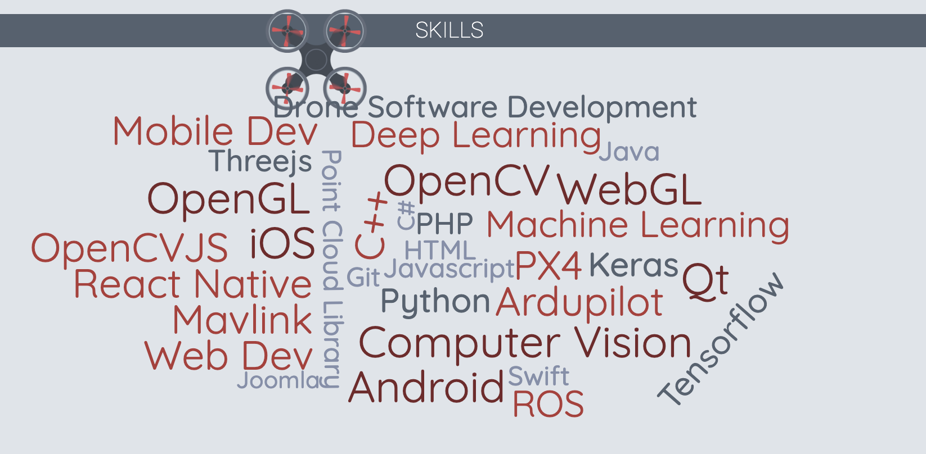
Before DS?

Slide 7
Challenges to be a DS
MENA:
Few opportunities.
Data is not the focus.
AMERICA:
Many opportunities.
VERY competitive.
PhD, MSc.

Slide 8
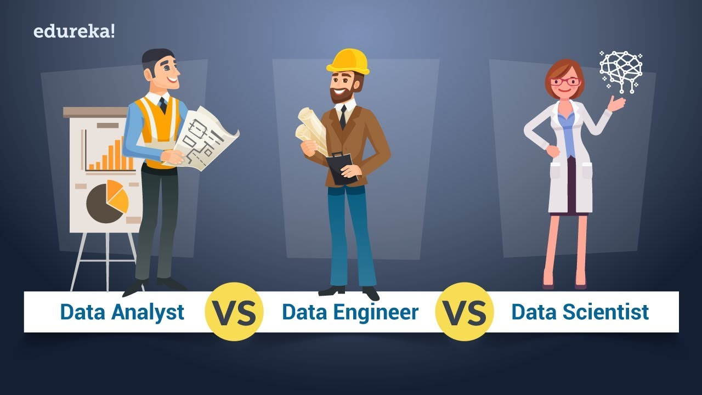
What are all these titles, Data Eng, Data SC, Data and Applied SC, ML Eng?
Data Engineer.
Data Analyst.
Data and Applied SC.
ML Eng, ML Researcher, DS.
MLOps Eng: DevOps
Data Analyst vs Data Engineer vs Data Scientist | Edureka

Slide 9

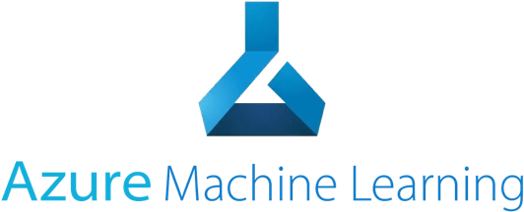
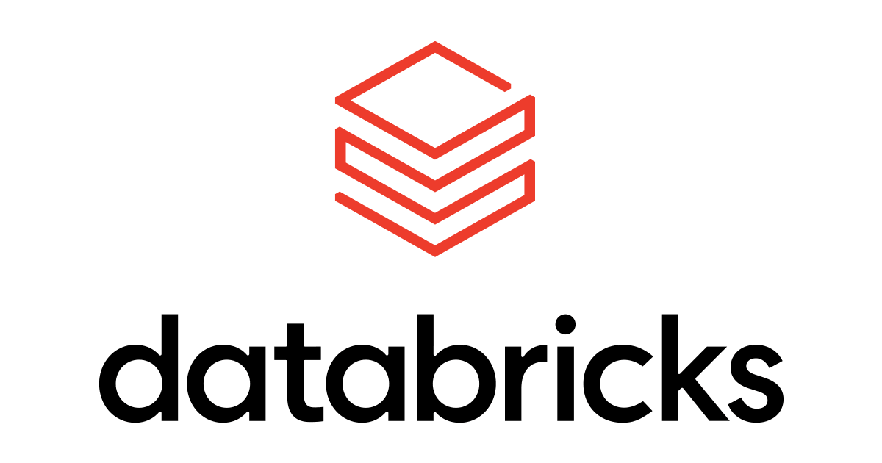




Why Cloud is essential?

Slide 10
Why Python?
Easy to learn language with simple syntax (compared to other languages).
Wide community of researchers and academics use it.
Large number of open-source libraries for data science tasks (don’t reinvent the wheel).
Deep learning and ML: TensorFlow, scikit-learn.
Data manipulation: pandas.
Data visualization: Matplotlib, seaborn.

Slide 11
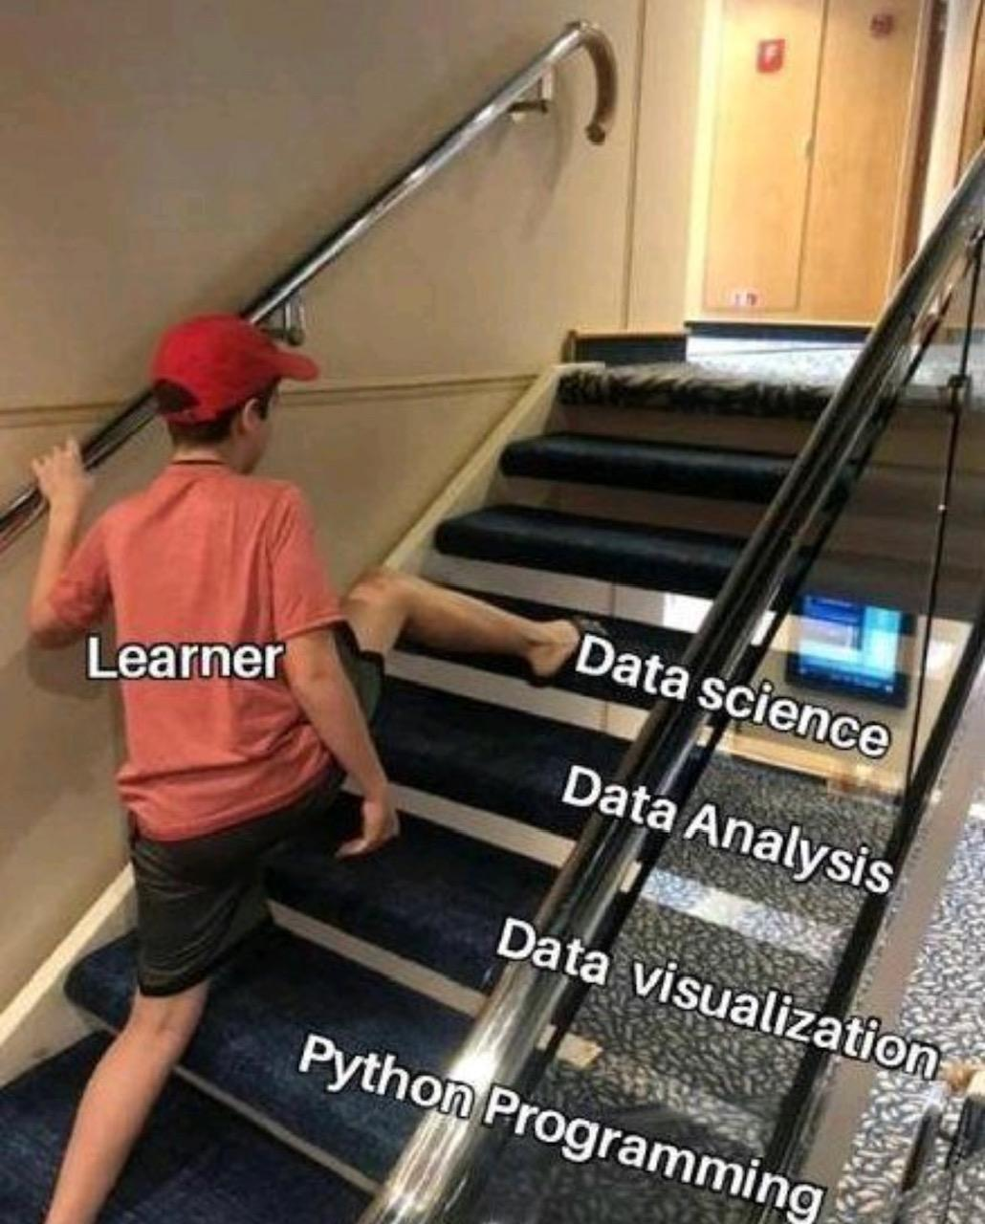
Why Data Analysis?
Learners often jump immediately to machine learning before understanding the basics, such as Python programming, data analysis, and visualization.

Slide 12
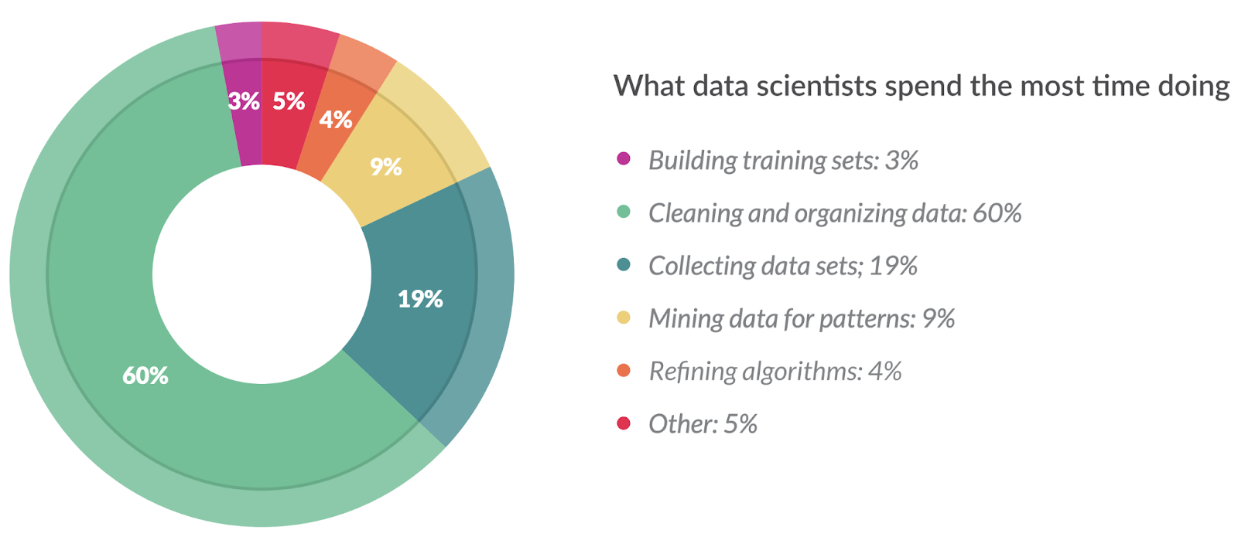
Why Data Analysis?
In one study, it was found that data scientists spend almost 60% of their time cleaning and manipulating data. Thus, it’s very important to become knowledgeable in the tools to analyze data.

Slide 13
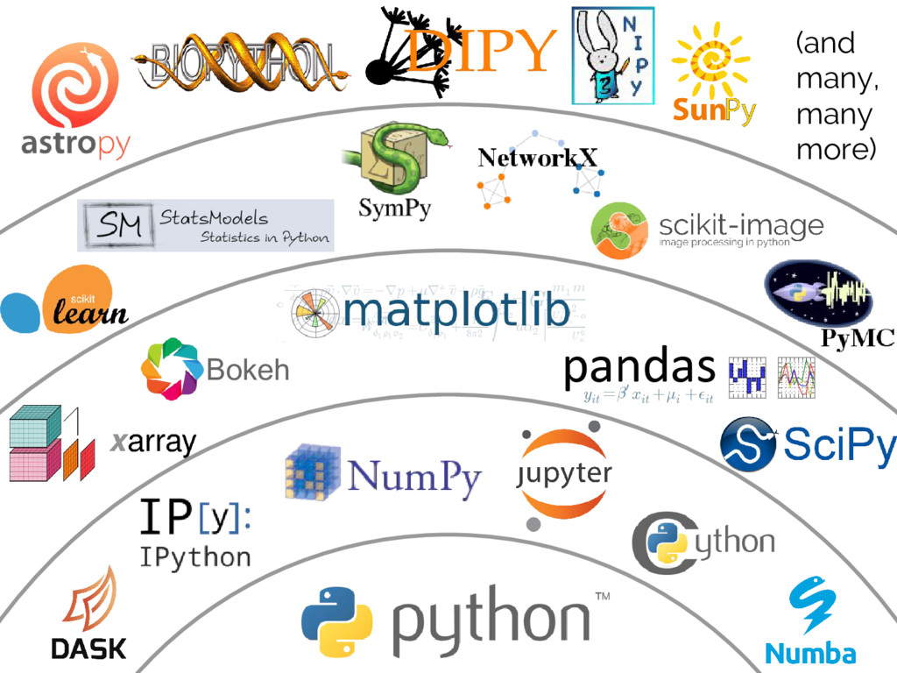
Why Pandas and NumPy?
They form the basis of scientific computing in in Python

Slide 14
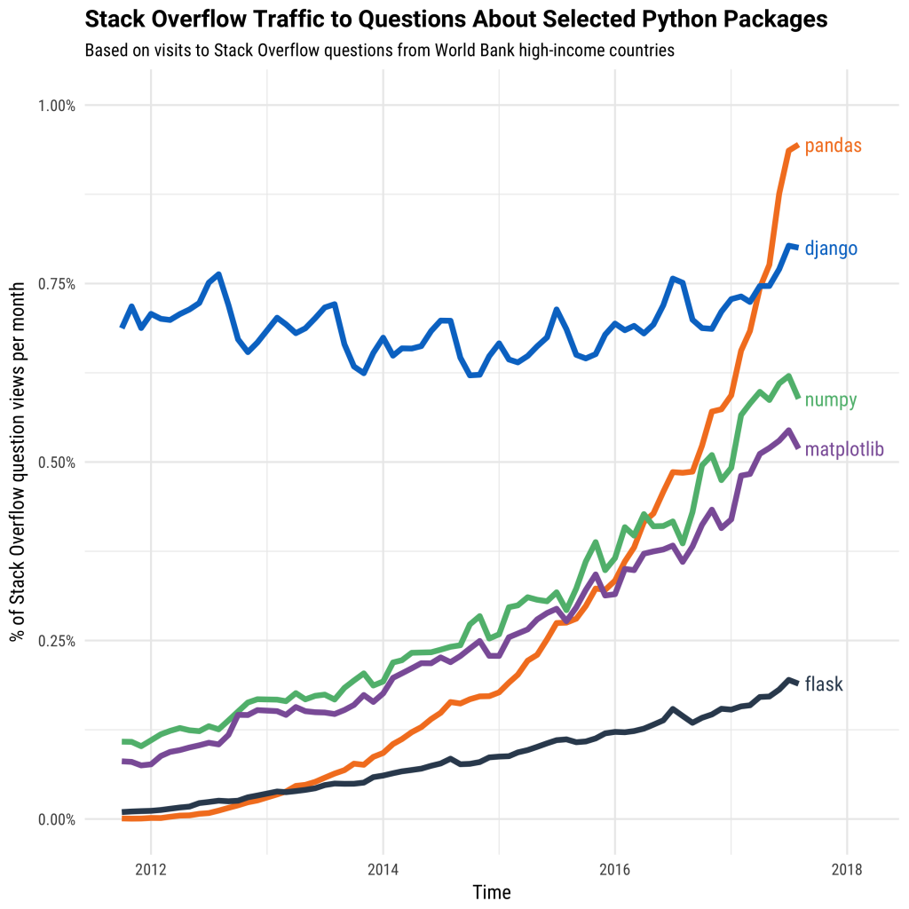
Why Pandas and NumPy?
Both libraries have been growing in popularity in the last 10 years.

Slide 15

What is Jupyter Notebook?
Data Analysis tasks often involves interacting with a dataset.
Different from traditional programming context.
A platform (or tool) is needed to facilitate this interactivity.
Jupyter notebook is a web-based interactive computing tool for creating language-agnostic notebooks.
One can create notebook in Python, R, or Julia.
A notebook is a combination of code cells and
Markdown cells.

Slide 16
Tour of jupyter notebook
What is a notebook?
What is a kernel?
Working on multiple notebooks simultaneously.
Writing code and markdown.

Slide 17

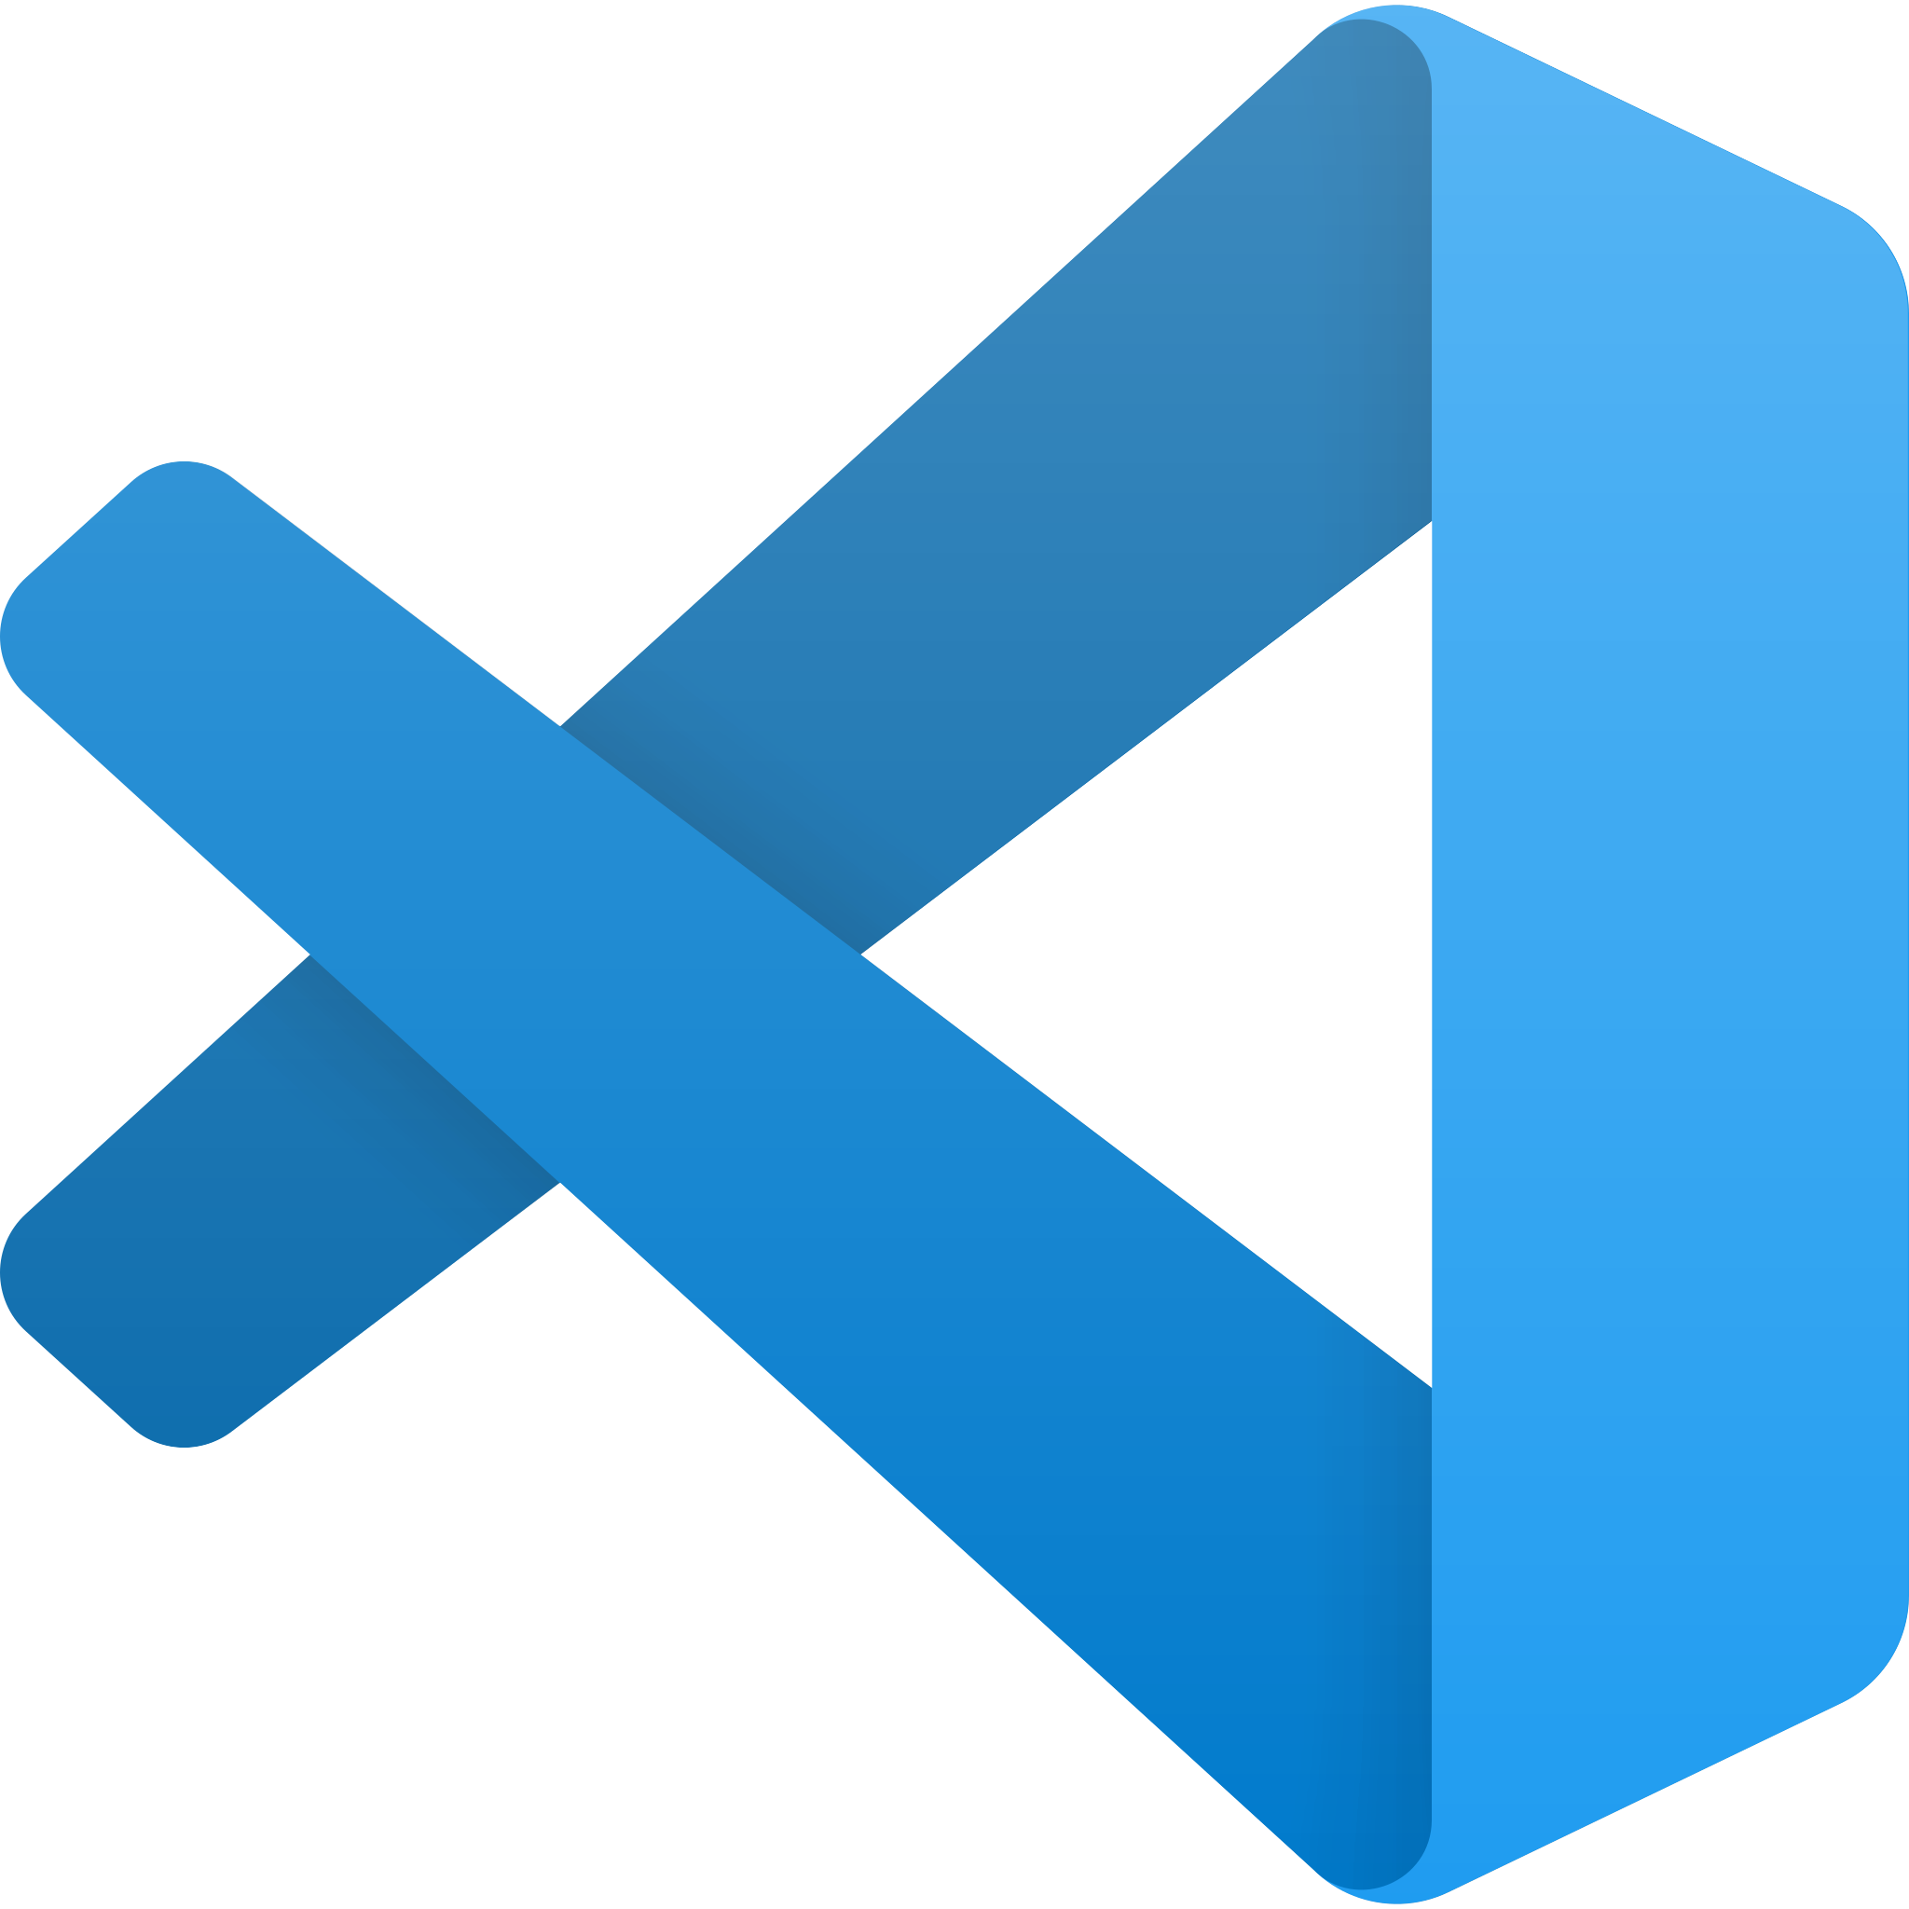


Common IDEs and tools
VS code
Google Colab
Anaconda
PyCharm

Slide 18
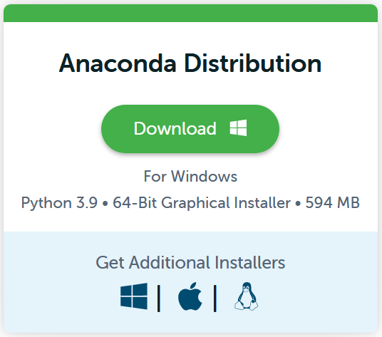
Installation:
Go to: https://www.anaconda.com/products/distribution
Depending on your OS, choose the right installation.

Slide 19
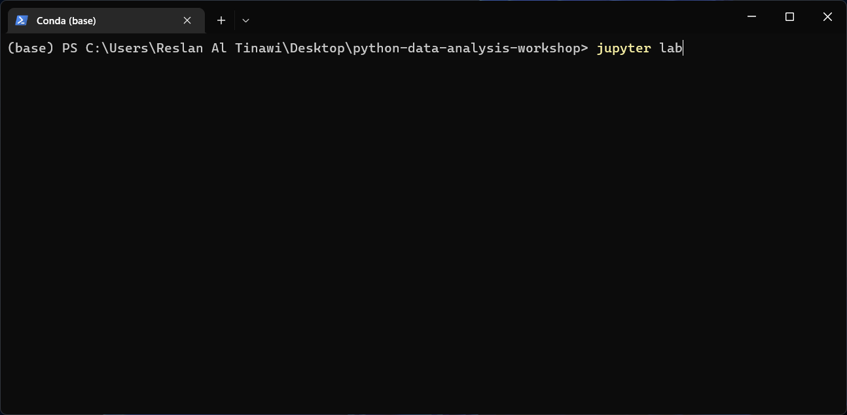
Installation (launching Jupyter):
In your terminal type: jupyter lab

Slide 20
Installation:
VS Code supports working with notebooks.
First, you should install the jupyter package (if not already installed) by running:
pip install jupyter
Then, you need to install the jupyter extension for VS Code from here.

Slide 21
Google Colab
If you don’t want to install anything at the moment, you can just use google colab by opening: https://colab.research.google.com/
All the notebooks for this workshop will be available on colab.

Slide 22




https://github.com/Reslan-Tinawi/python-data-analysis-workshop
reslan.tinawi@syssr.org
https://www.linkedin.com/in/reslan-al-tinawi/
soubhi.hadri@syssr.org
https://www.linkedin.com/in/soubhihadri/

